Slide 1

Note: The data and information in this document is reflective of a hypothetical situation and client. This document is to be used for KPMG Virtual Internship purposes only.
Sprocket Central Pty Ltd
Data analytics approach
[Division Name] - [Engagement Manager], [Senior Consultant], [Junior Consultant]

Slide 2
Note: The data and information in this document is reflective of a hypothetical situation and client. This document is to be used for KPMG Virtual Internship purposes only.
Agenda
1. Data Exploration
2. Model Development
3. Interpretation

Slide 3
Note: The data and information in this document is reflective of a hypothetical situation and client. This document is to be used for KPMG Virtual Internship purposes only.
Introduction
Method for Analyzing New Customer Data:
Distribution by age
Buying a bike
Job market
Amount of vehicles owned.

Slide 4
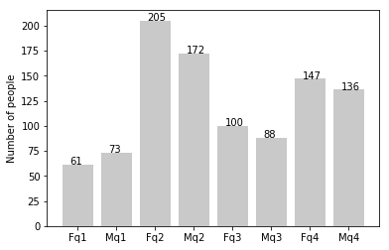
Note: The data and information in this document is reflective of a hypothetical situation and client. This document is to be used for KPMG Virtual Internship purposes only.
Data Exploration
Distribution by age
As you can see, most of our new consumers are between the ages of 25 and 48.
There are significant percentage declines in consumer numbers between the ages of 48 and 59.
In terms of percentages, there is a modest rise in the number of clients above 59.
The proportions of those under 25 seem to have barely changed..

Slide 5
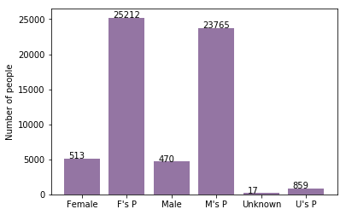
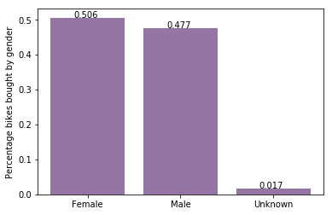
Note: The data and information in this document is reflective of a hypothetical situation and client. This document is to be used for KPMG Virtual Internship purposes only.
Model Development
Buying a Bike
As we can see, most of our new customers—50.6% of whom made purchases totaling 25,212 bikes—were women.
Men made 23,765 motorcycles and 47.7% of the purchases.
Therefore, we should do so to women rather than focusing on advertising to men.

Slide 6
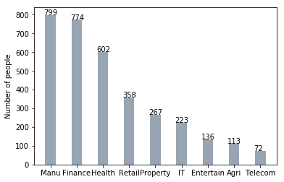
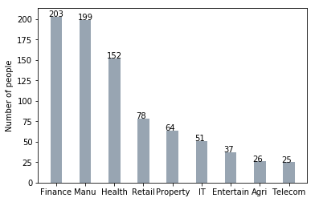
Note: The data and information in this document is reflective of a hypothetical situation and client. This document is to be used for KPMG Virtual Internship purposes only.
Interpretation
Job Market
Most of our new clients come from the finance sector, and our manufacturing clients continue to rank second.
The remaining industries remain the same.

Slide 7
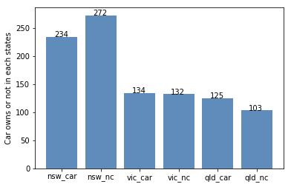
Note: The data and information in this document is reflective of a hypothetical situation and client. This document is to be used for KPMG Virtual Internship purposes only.
Interpretation
Amount of Vehicles Owned
Given that a more significant proportion of consumers in NSW do not own automobiles than do, NSW should be given priority.
Customers who possess cars are more numerous in VIC and QLD than those who don't, but we may strive to make it so that those who purchase bikes.

Slide 8
Note: The data and information in this document is reflective of a hypothetical situation and client. This document is to be used for KPMG Virtual Internship purposes only.
Thank You

